Slide 1

Example Perplexity and Label Cleaning
QIU Yaowen 20784389
yqiuau@connect.ust.hk

Slide 2

Content
I. Motivation & Background
II. Methodology
III. Experiment
IV. Results & Analysis
V. Conclusion

Slide 3
Motivation
Some Examples are easier for humans to classify than others -> This should be also applied on DNNs
Previous works that consider classification difficulty are not ideal (rely on human, some are not about examples themselves )
Example Perplexity is proposed by Prof. ZHANG

Slide 4

Dataset - ImageNet
1000 Categories
1.28 M Training Images + 50,000 Validation Images

Slide 5
Preparation of Perplexity
Select 10 main-stream Model
(e.g. VGG, ResNet, Xception …)
Create 10 Training set/subset
(100% * 1 + 25%*3 + 50%*3 + 75% *3)
Train for each (model, data) pair
Choose 5 models at different stages
Total 10 * (9+1) * (4+1) = 500 Models

Slide 6
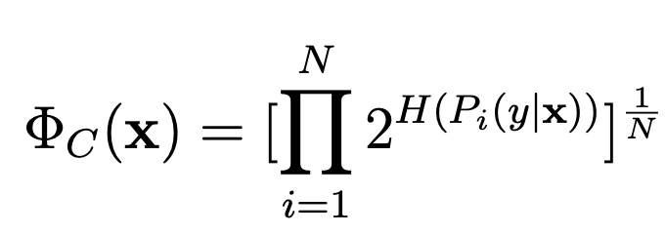
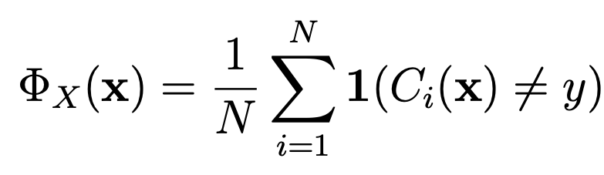
C-Perplexity and X-Perplexity
indicates the confidence that classifiers have when classifying the example. Higher C-perplexity, lower confidence. Minimum value = 1
Fraction of the classifiers that misclassifies the example, hence is between 0 and 1.

Slide 7
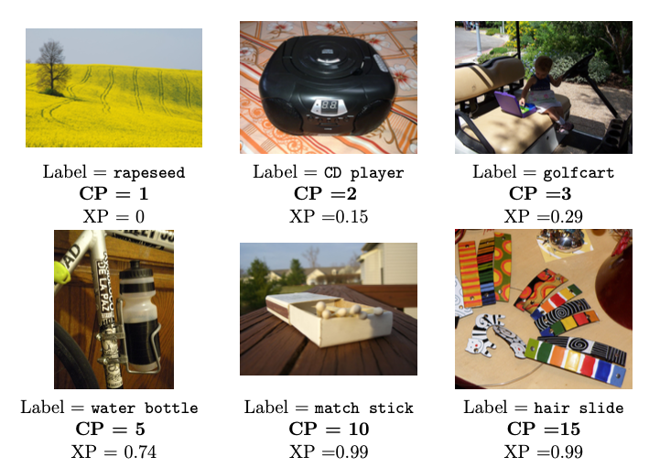
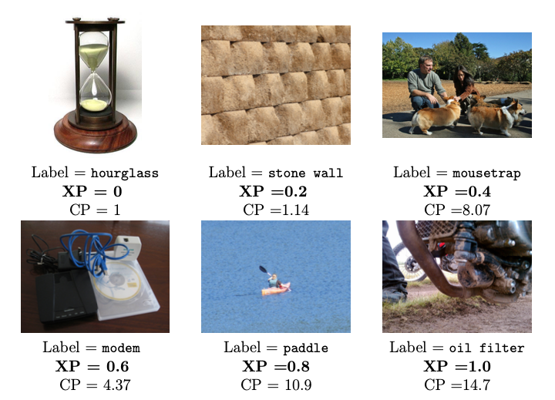
Observation
Examples with varying C-perplexity values.
Examples with varying X-perplexity values.

Slide 8
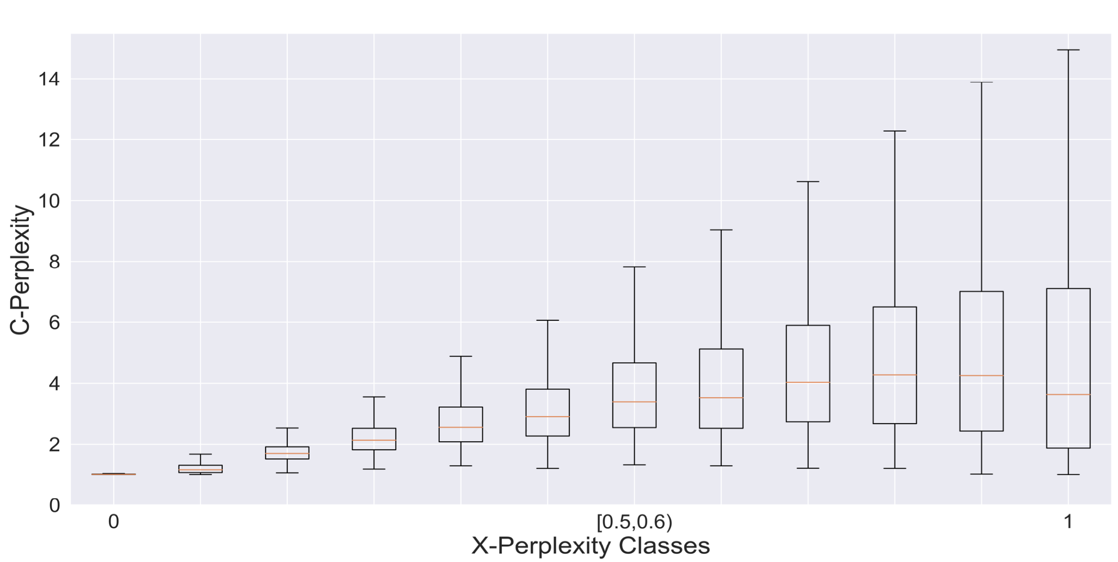
Correlation between C-Perplexity & X-Perplexity

Slide 9
Purpose of the Project
Perform different data cleaning / training methods based on the perplexity of Training Images to train different models
Explore whether the adopted methods have positive/negative effect on the performance on validation set
Discuss & Analysis the experimental

Slide 10
Content
I. Motivation & Background
II. Methodology
III. Experiment
IV. Results & Analysis
V. Conclusion

Slide 11
Overall Framework
Training data
Data Pre-Processing
Do Nothing
Pruning
Weight Reassignment
Train on same way
Baseline Model
Model *
Model *
Validation I
Validate & Compare Performance
Validation II (v2)
(see page. 28)

Slide 12
Evaluation
Loss Function
- CE Loss
Metrics
- Top 1/ Top 5 Accuracy on Valid I & Valid II
- Top 1 / Top 5 Accuracy gap between Valid I & Valid II
Example-based analysis

Slide 13
Percentile based Example Pruning
Sort the training examples based on X_Perp/C_Perp in ascending order, respectively.
Define a threshold of percentile to prune examples larger than the threshold
.95
.90
.85
To maintain the label balance, randomly duplicates N examples from each category with replacement, where N = # of pruned examples
Train & Evaluate Model based on new Training data

Slide 14
Statistics of Pruning
Threshold | # of examples pruned by C-Perplexity | # of examples pruned by X-Perplexity | # of examples pruned (OR) | % of examples pruned
.95 | 64,059 | 63,278 | 107,107 | 8.36%
.90 | 128,117 | 127,572 | 194,140 | 15.17%
.85 | 192,175 | 191,792 | 269,967 | 21.09%

Slide 15
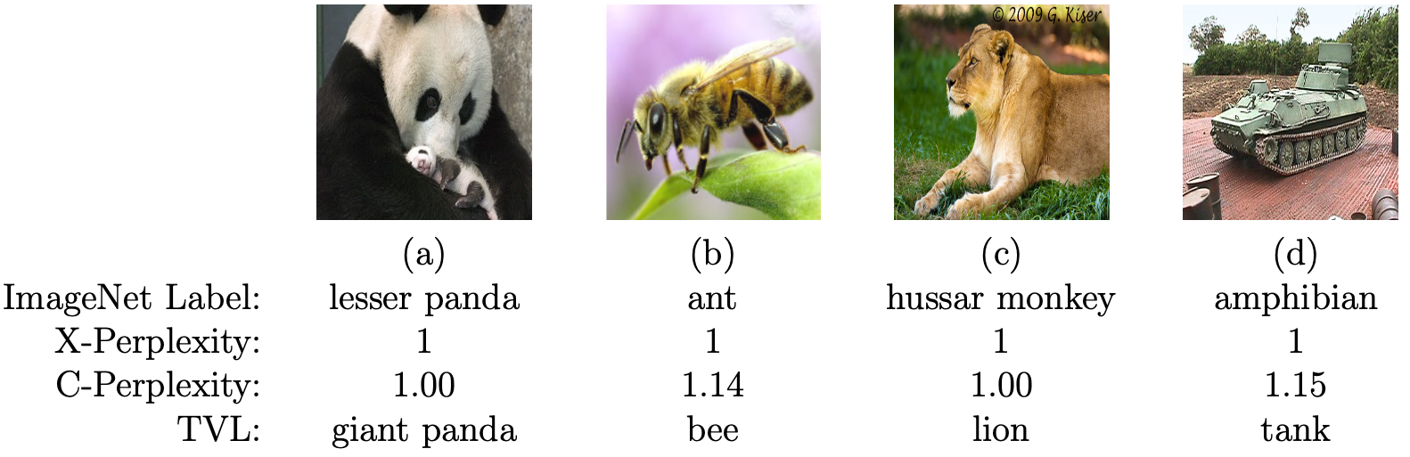
Prune examples likely to mislabeled
Mislabeled examples do exist in both training set and validation set
Tends to has high X-Perplexity and low C-Perplexity

Slide 16
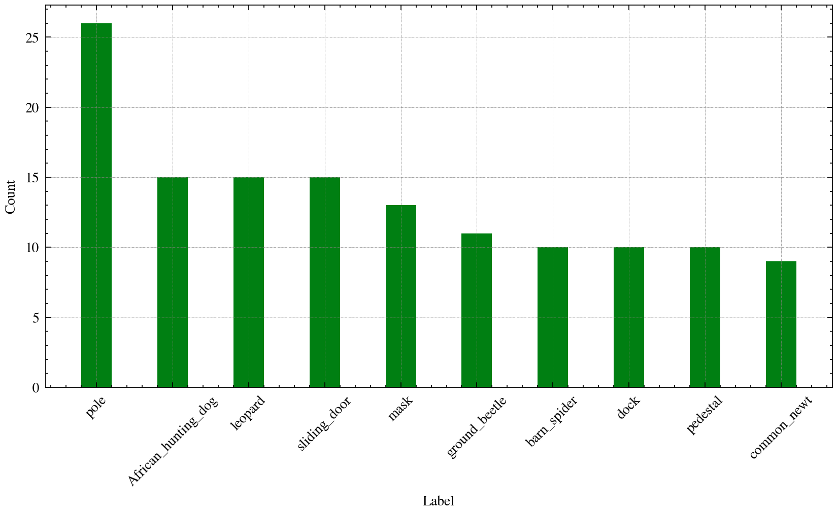
Prune examples likely to mislabeled
Prune examples with X-Perplexity >= 0.8 & C-Perplexity <= 1.2
It will be better if correcting this examples’ label using Top Vote Data (which is deleted). I Personally think it would be more effective
Threshold | # of examples pruned | % of examples pruned
X-Perplexity = 0.8 C-perplexity = 1.2 | 997 | 0.08%

Slide 17
Weight Reassignment
Ideas:
1. Examples with high perplexity can be treated as outliers
2. Model should not pay equal attention on those -> less weights

Slide 18
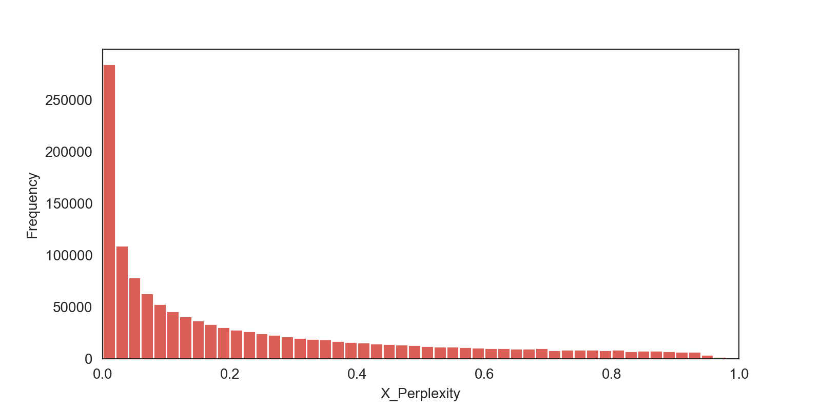
Review of distribution of X Perplexity

Slide 19
Property of Weight Function
We want examples with higher perplexity have lower weights. Therefore, the designed weight function should have following property:
1. the weight of examples should be monotonically decreasing with its X-perplexity
2. The derivative of the weight function should also decrease monotonically.

Slide 20
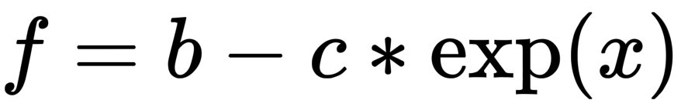
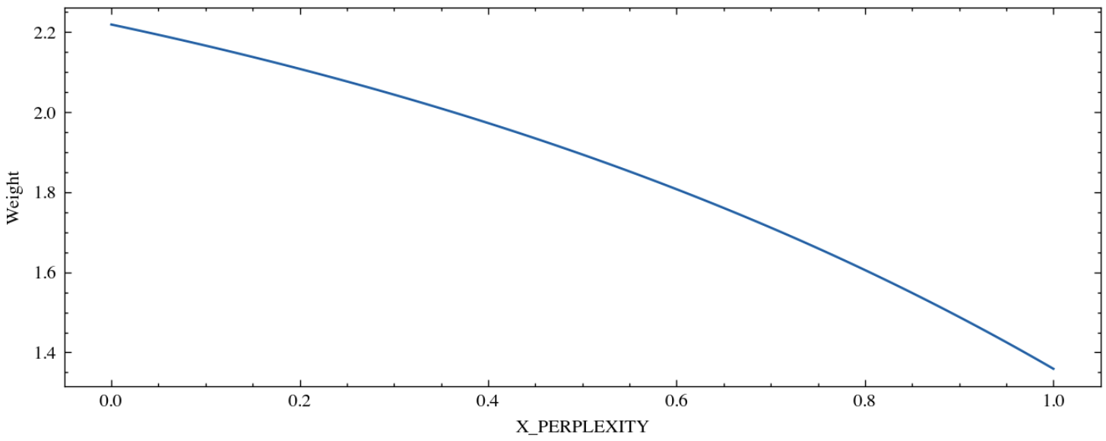
Weight Function of X Perplexity
For the weight, we want:
1. The minimum weight should greater than zero
2. The gap (maximum / minimum), should not be too large, e.g. gap = 2. And we have b = gap * c * e
C = 0.5 and b = e in this case

Slide 21
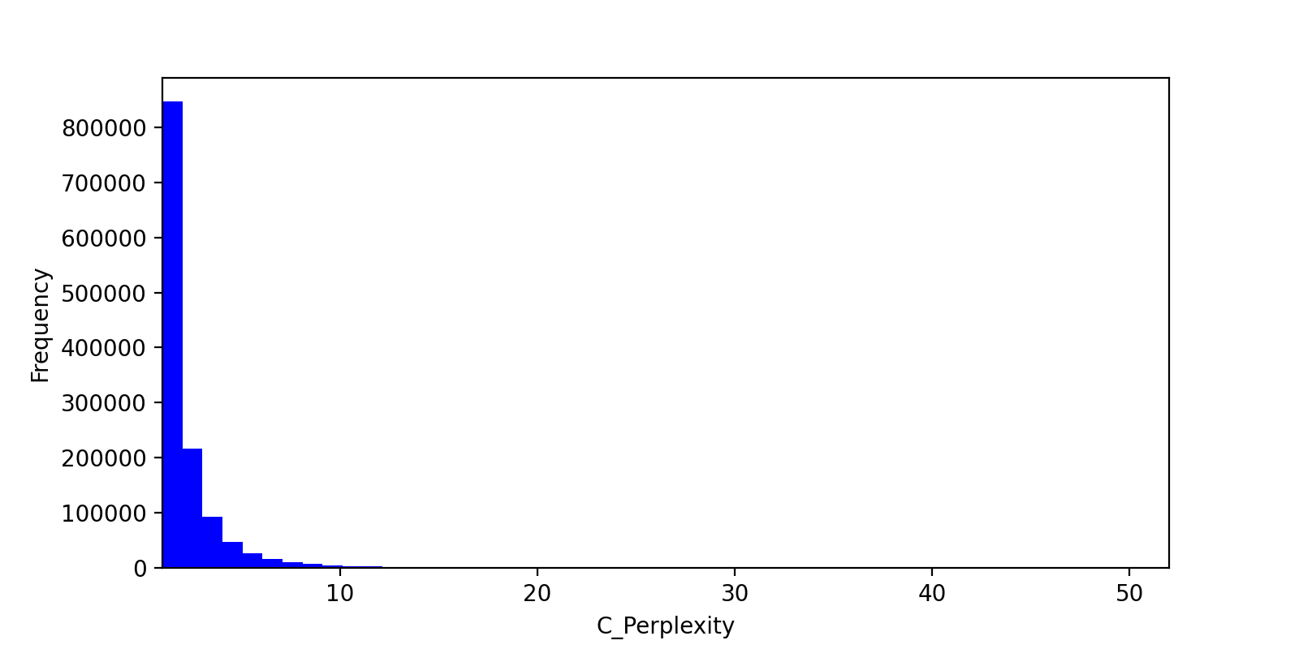
Review of distribution of C Perplexity
Here locates thousands of examples

Slide 22
Property of Weight Function
The existence of extreme outliers requires to change the property of weights assignment function:
1. the weight of examples should be monotonically decreasing with its C-perplexity
2. The derivative of the weight function should also decrease with C Perplexity when it is small and increase with C Perplexity when it is large.

Slide 23
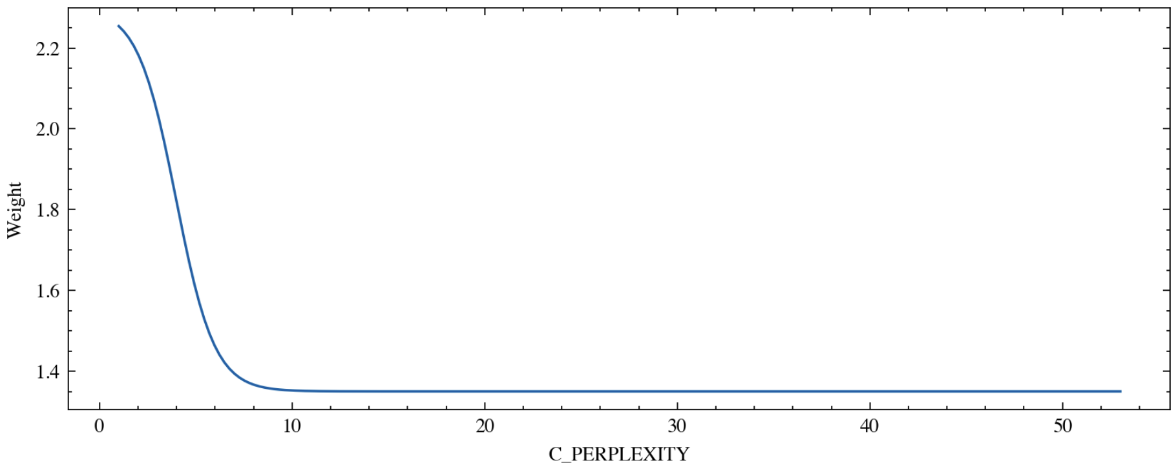
Weight Function of X Perplexity
b = 2.3, c = 0.95, delta = 3.98(90% percentile of C Perplexity)

Slide 24
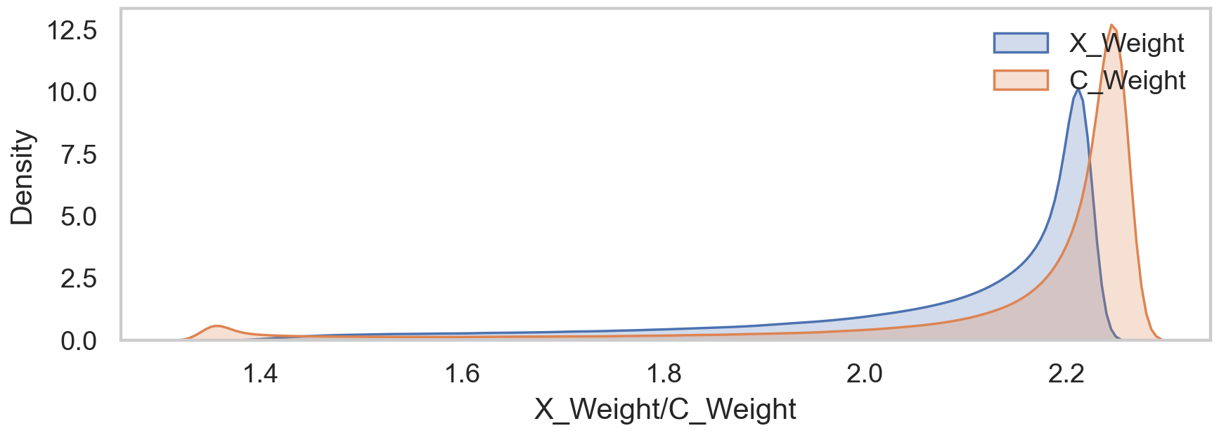
Distribution of New Weight

Slide 25
Content
I. Motivation & Background
II. Methodology
III. Experiment
IV. Results & Analysis
V. Conclusion

Slide 26
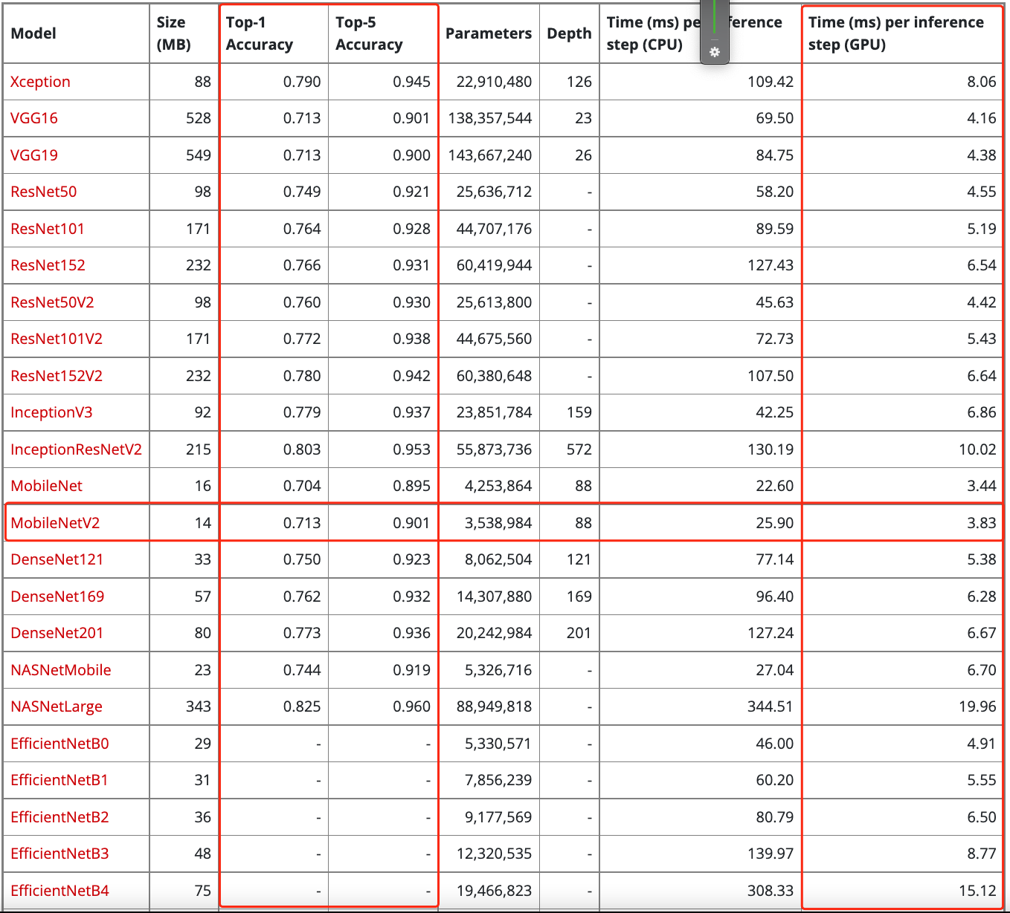
Baseline – Mobilenetv2
Acceptable Accuracy
Advantage in speed

Slide 27
Baseline – Global Training Hyper-parameters
Equipment:
3 * GTX 1080Ti, 8GB Memory each
Parameters:
Epochs = 50
train_batch_size = 256
input_shape = (224,224)
optimizer = SGD(learning rate=0.01, momentum=0.8), with step decay 0.1 per 10 epochs, Minimum learning rate = 1e-5
Pre-processing:
Normalization : Rescale image
Randomness Control
Set seed to control the sequence of batch examples in data generator
Each model use same initial parameters

Slide 28
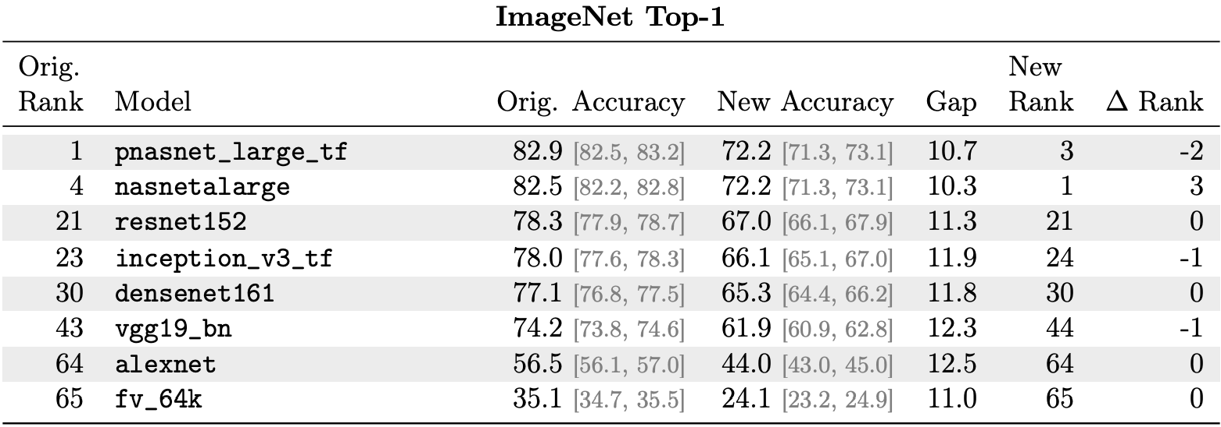
Dataset – ImageNetv2
10,000 Validation Images
Generated To measure the generation ability of the models
A huge drop of Top-1 Accuracy happens in all models

Slide 29
Content
I. Motivation & Background
II. Methodology
III. Experiment
IV. Results & Analysis
V. Conclusion

Slide 30
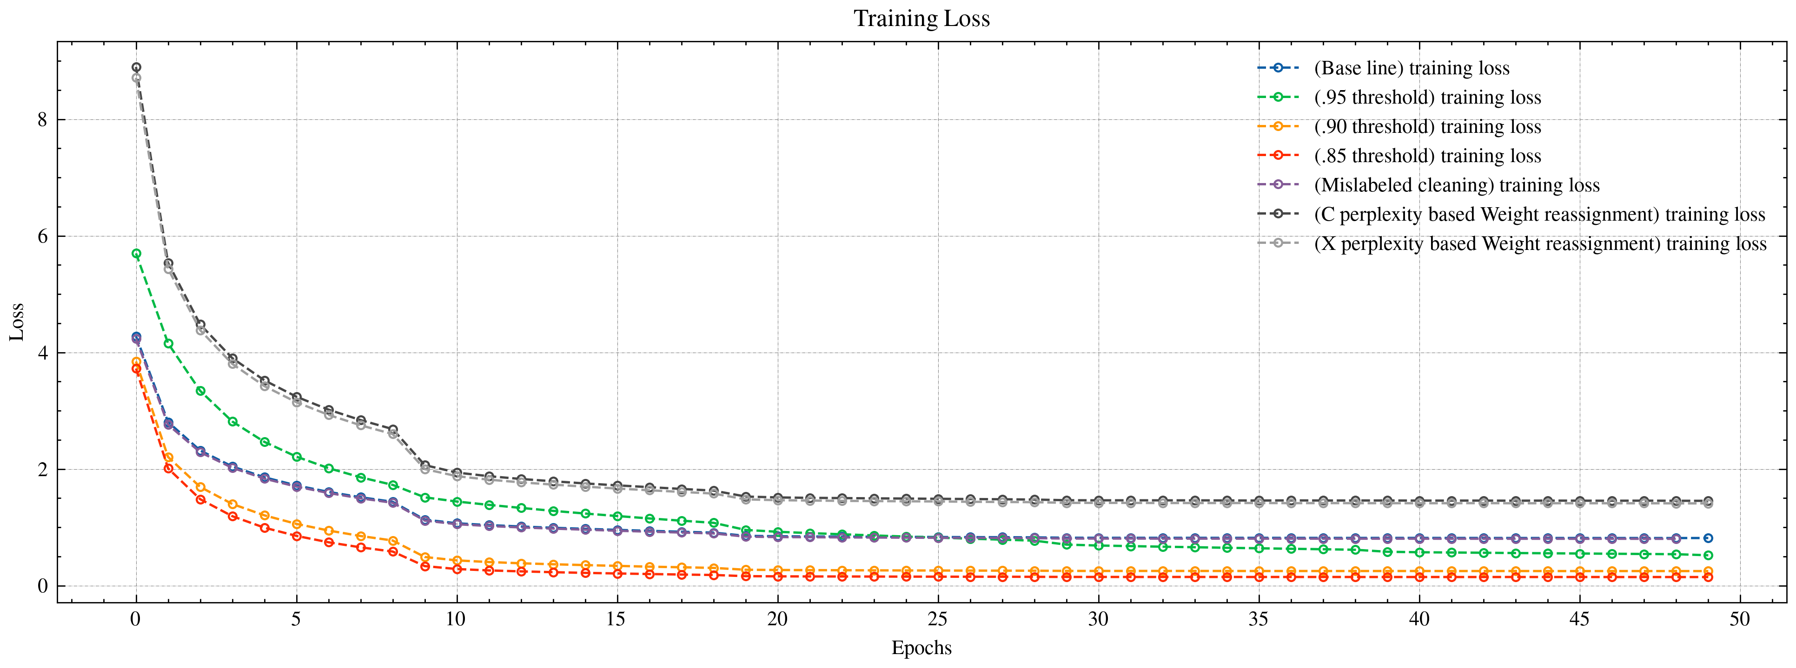
Training Loss

Slide 31
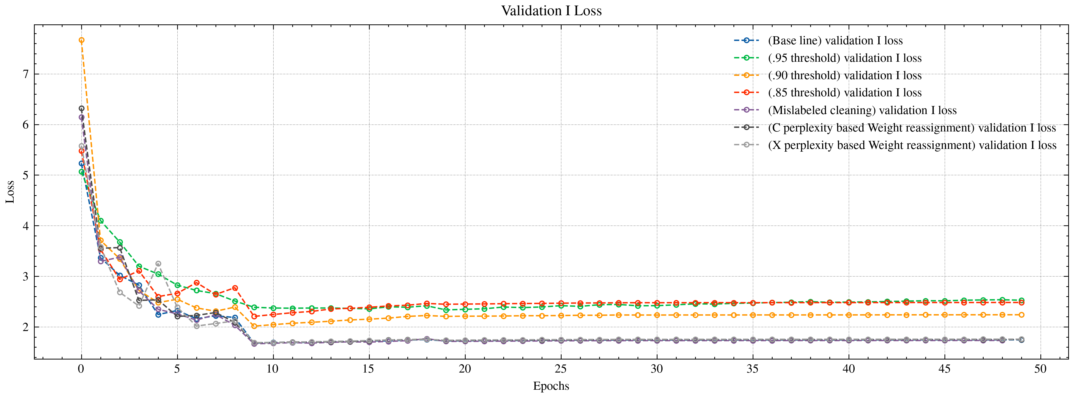
Validation set I Loss

Slide 32
Result Table
Neutral
Negative
Positive
Model | Training Set |  | Validation I |  | Validation II |  | Gap (I – II)
 | Top-1 | Top-5 | Top-1 | Top-5 | Top-1 | Top-5 | Top-1 | Top-5
Baseline | 78.73% | 93.97% | 60.60% | 83.26% | 48.26% | 71.56% | 12.34% | 11.7%
.95 Pruning | 87.52% (+8.79%) | 98.23% (+4.26%) | 60.54% (-0.06%) | 82.61% (-0.65%) | 47.90% (-0.36%) | 71.43% (-0.13%) | 12.64% (+0.30%) | 11.18% (-0.52%)
.90 Pruning | 92.90% (+14.17%) | 99.43% (+5.46%) | 60.60% (0%) | 82.02% (-1.24%) | 47.92% (-0.34%) | 70.57% (-0.99%) | 12.68% (+0.34%) | 11.45% (-0.25%)
.85 Pruning | 96.11% (+17.38%) | 99.81% (+5.84%) | 60.18% (-0.42%) | 81.05% (-2.21%) | 48.15% (-0.11%) | 69.22% (-2.34%) | 12.03% (-0.31%) | 11.83% (+0.13%)
Pruning (Mislabeled) | 78.98% (+0.25%) | 94.10% (+0.13%) | 60.86% (+0.26%) | 83.29% (+0.03%) | 48.15% (-0.11%) | 71.78% (+0.22%) | 12.71% (+0.37%) | 11.51% (-0.19%)
Weight (X) | 80.31% (+1.58%) | 93.92% (-0.05%) | 61.23% (+0.63%) | 83.63% (+0.37%) | 48.68% (+0.42%) | 71.96% (+0.40%) | 12.55% (+0.21%) | 11.67% (-0.03%)
Weight (C) | 80.19% (+1.46%) | 93.71% (-0.26%) | 61.41% (+0.81%) | 83.42% (+0.16%) | 48.48% (+0.22%) | 72.08% (+0.52%) | 13.37% (+1.03%) | 11.34% (-0.36%)

Slide 33
Result Table
Neutral
Negative
Positive
Validation III = images in Validation set I with X-PERP > 0.8
# : 8946, 17.9% of Validation set I
Model | Validation III
 | Top-1 | Top-5
Baseline | 4.88% | 38.01%
.95 Pruning | 4.82% (-0.06%) | 35.54% (-2.47%)
.90 Pruning | 4.33% (-0.55%) | 33.22% (-4.79%)
.85 Pruning | 3.57% (-1.31%) | 30.11% (-7.90%)
Pruning (Mislabeled) | 4.85% (-0.03%) | 38.05% (+0.04%)
Weight (X) | 5.21% (+0.33%) | 37.82% (-0.19%)
Weight (C) | 4.63% (-0.25%) | 38.20% (+0.19%)
Worse performance in classifying difficult examples
Keep generalization ability in difficult examples

Slide 34

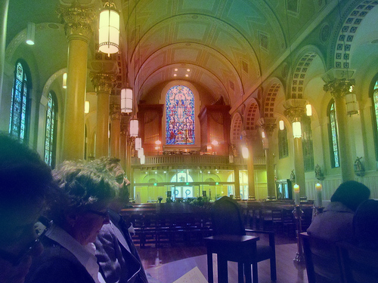
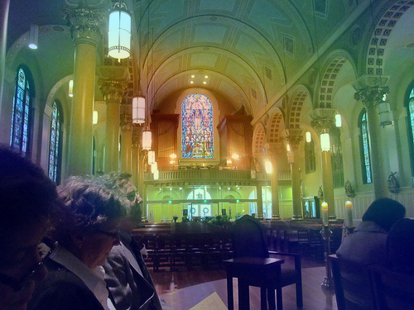



A possible explanation using Grad-CAM
Ground Truth: Altar
XP = 0.85 CP = 3.3
Baseline : Altar
.95 threshold : Altar
.90 threshold : Restaurant
.85 threshold : Restaurant
Weight (C) : Altar

Slide 35
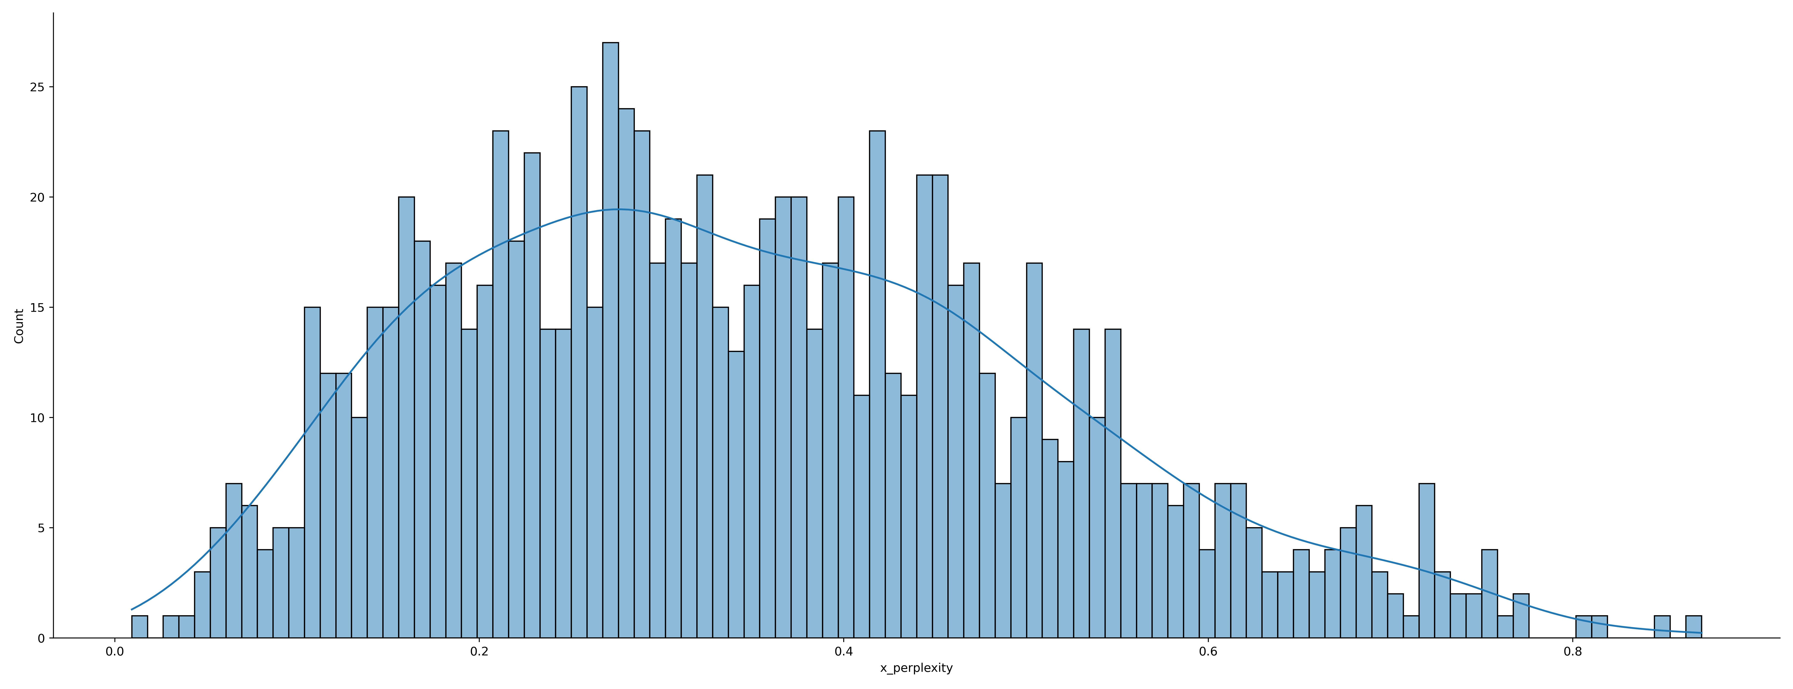
Analysis based on classes
Level | Avg. X-Perplexity | # of classes
Easy | 0.11 | 50
Middle | 0.42 | 50
Hard | 0.71 | 50

Slide 36
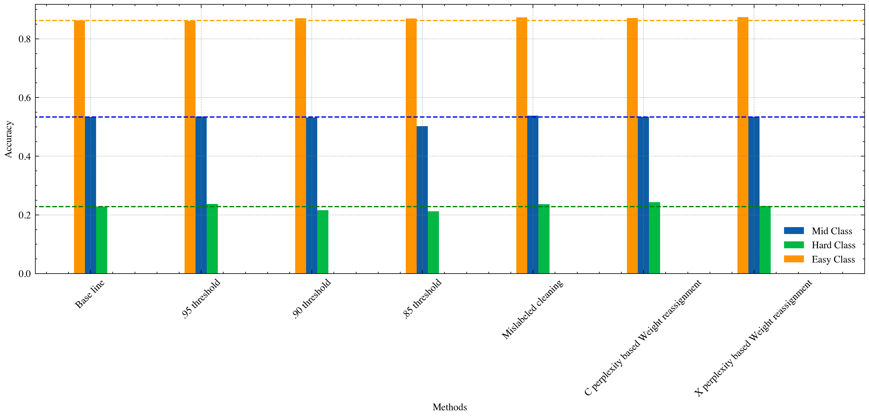
Accuracy of three classes in Validation set I

Slide 37
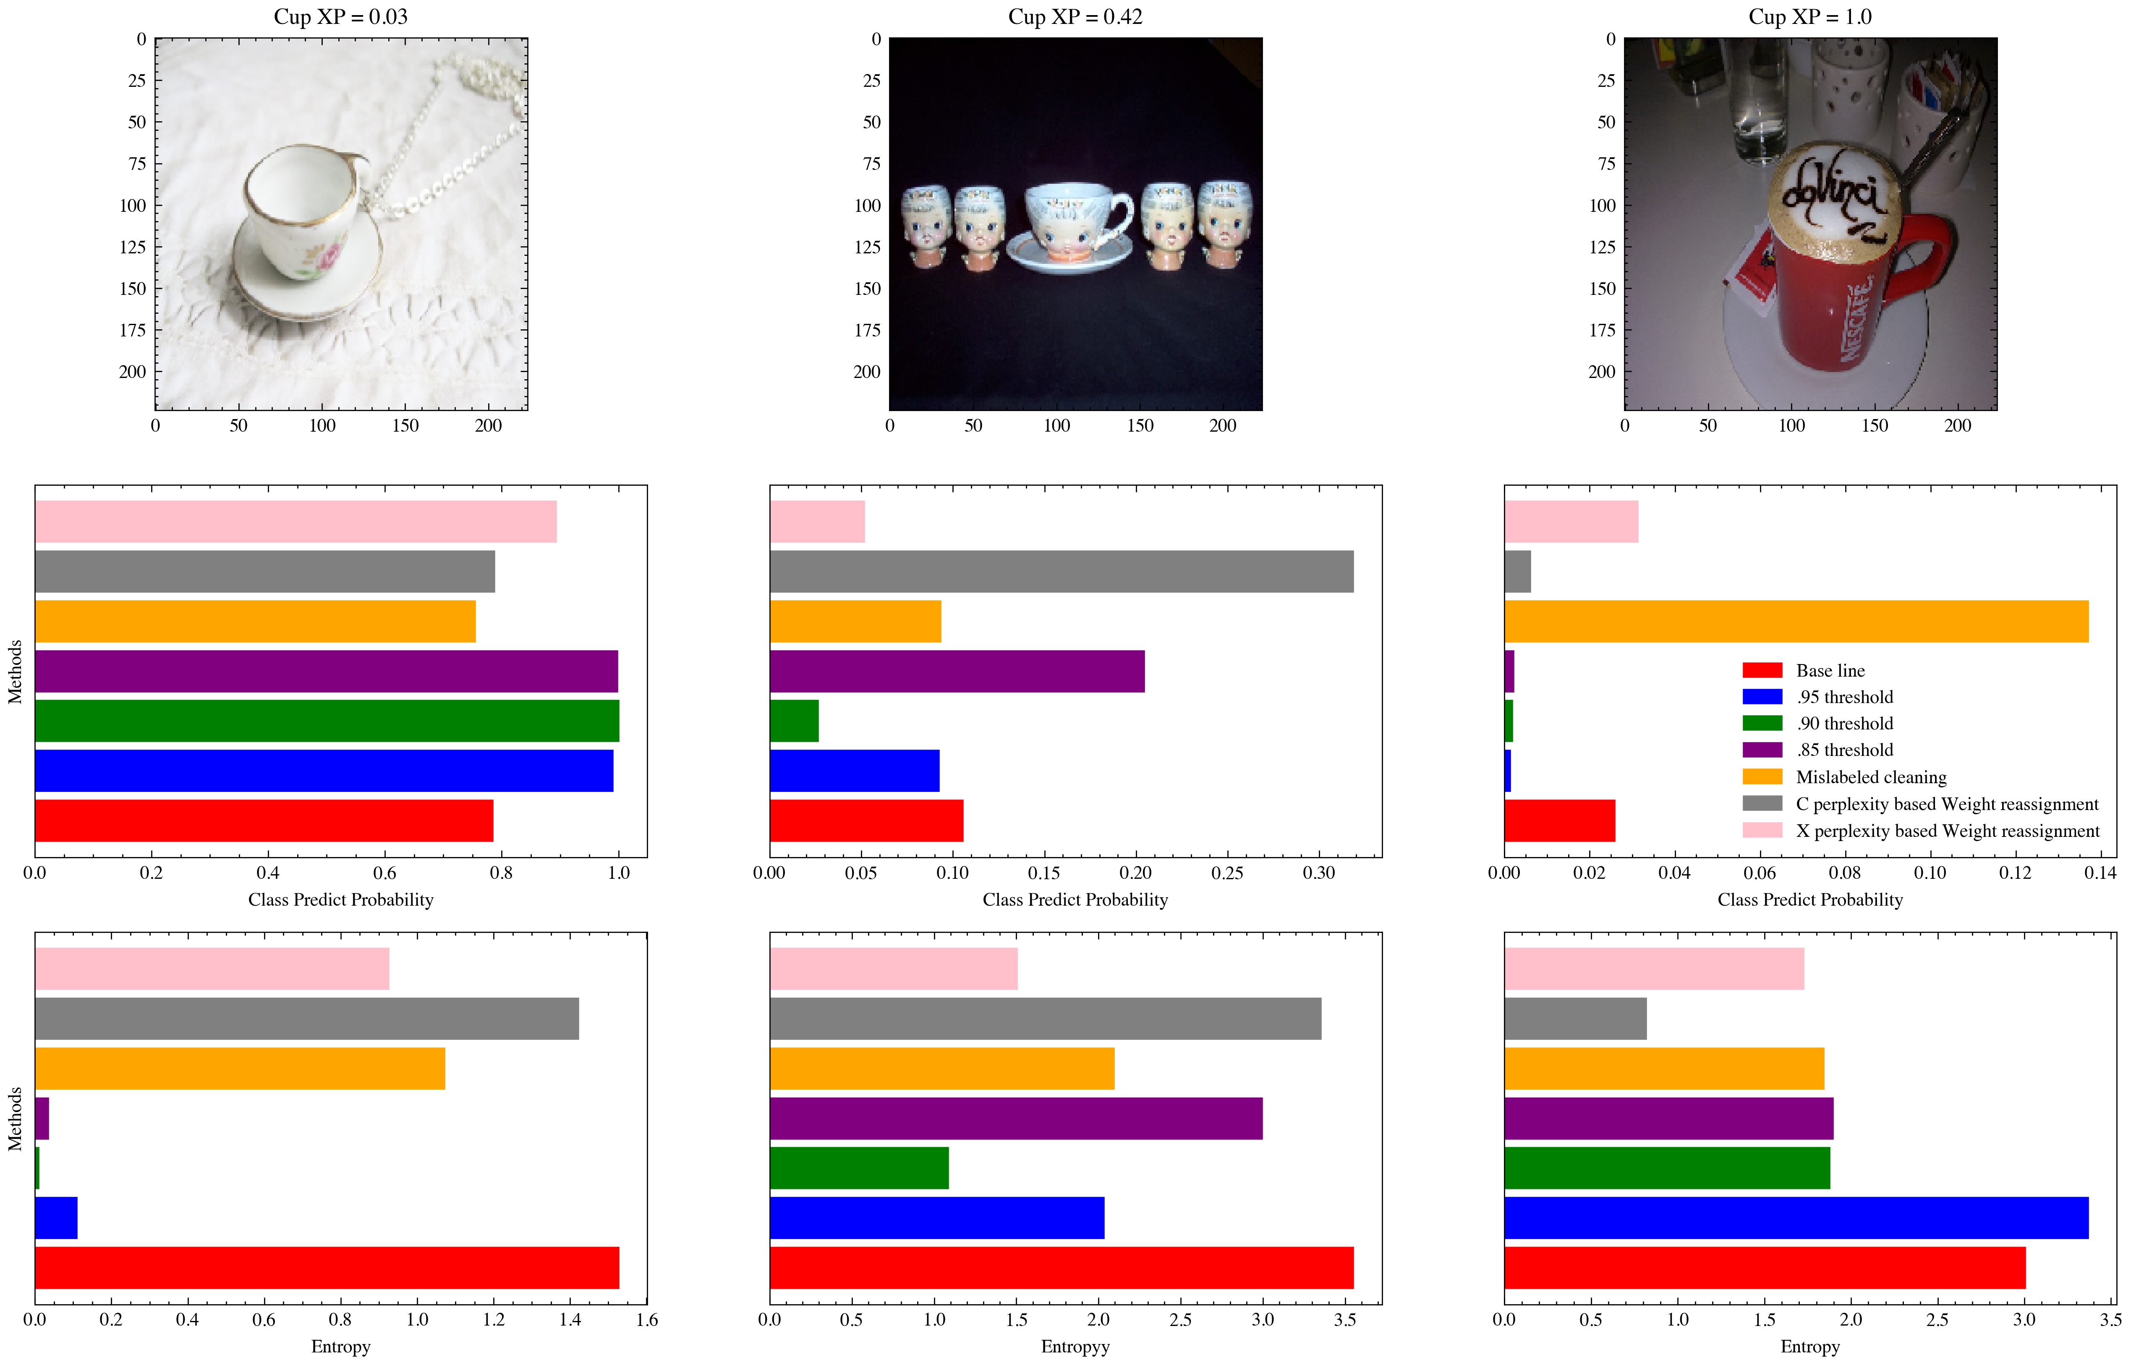
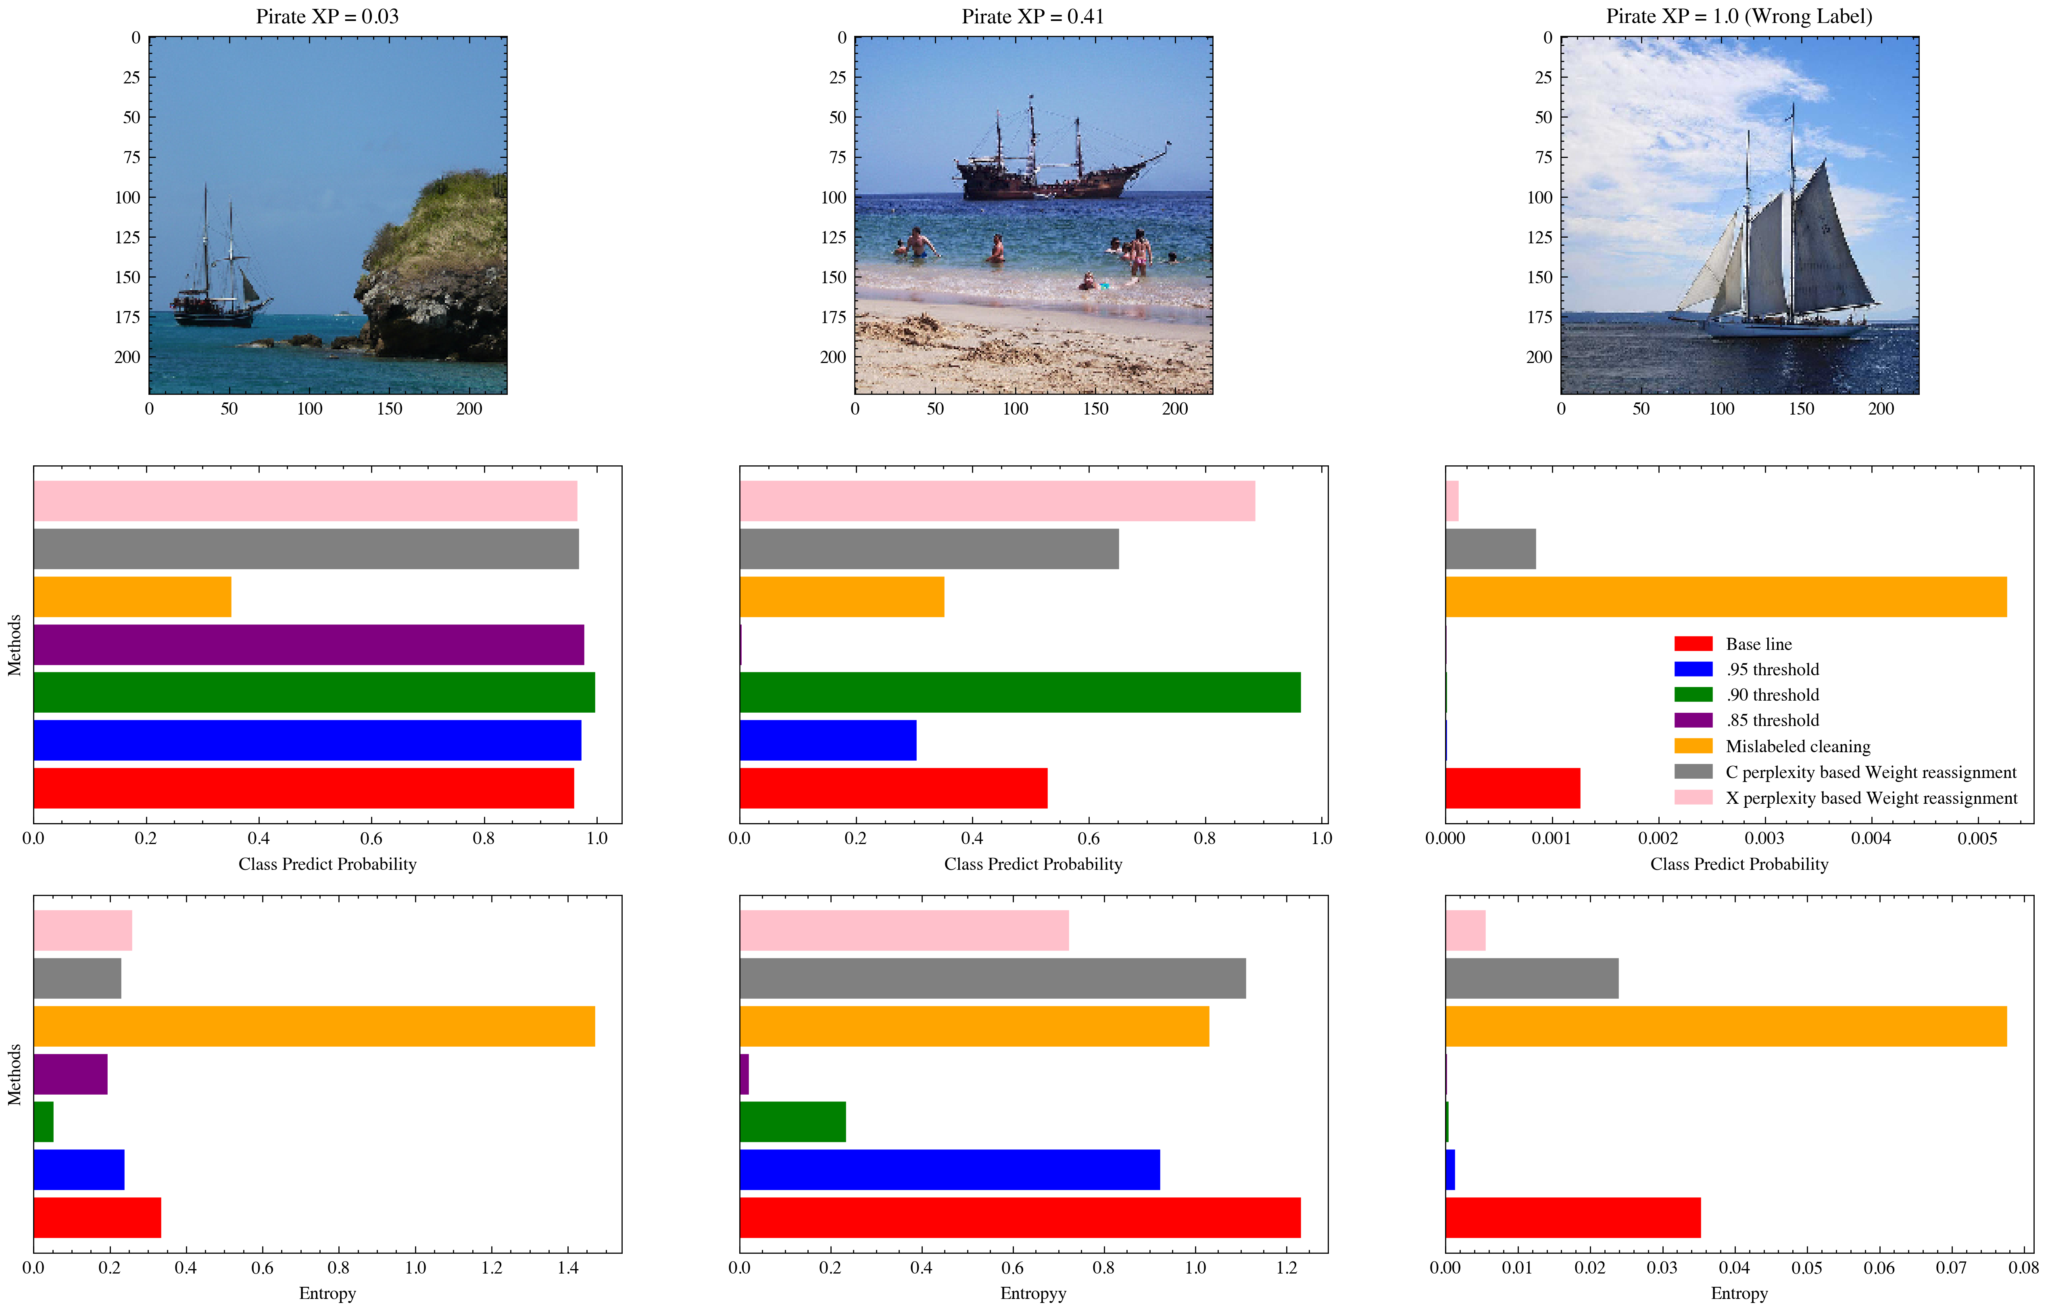
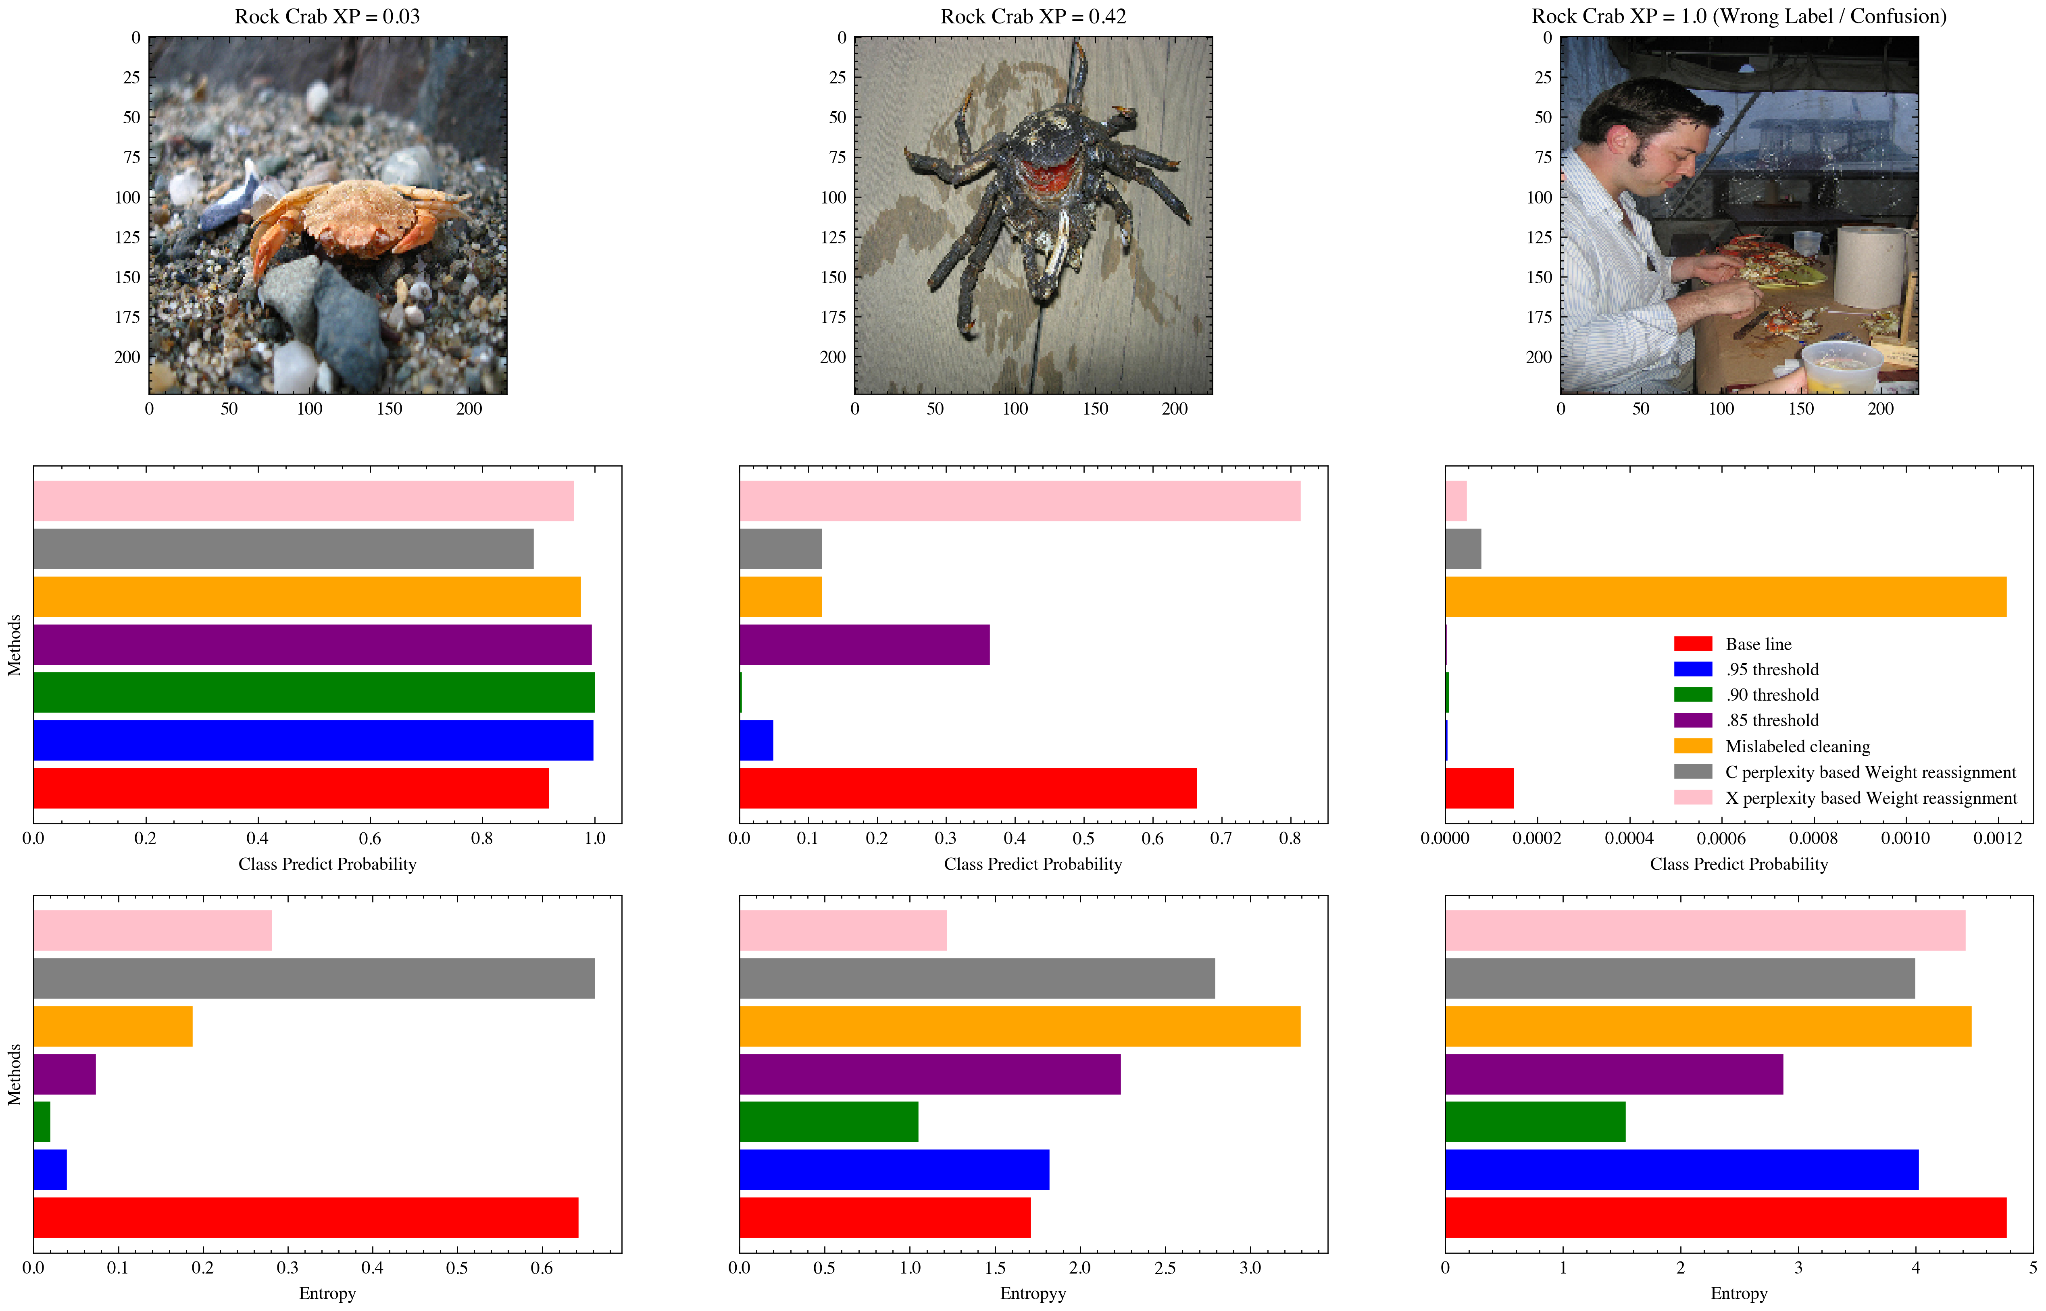
Prob. Bar & Entropy Bar plot
When XP is low, most of models have higher prob. and lower entropy (compared to base line);
When XP is middle, some models have higher prob. but some have lower prob. However, all models have lower entropy
When XP is high (Probably it is mislabeled), most of models have even lower prob. & lower entropy (except the orange one)

Slide 38
Content
I. Motivation & Background
II. Methodology
III. Experiment
IV. Results & Analysis
V. Conclusion

Slide 39
Summary
All of methods have No/Negative impact on the loss of validation set
Percentile pruning methods have Negative impact on the model.
Probably due to a large fraction of “difficult examples” are pruned, lead to worse ability to classify “difficult examples”
Model pay less attention on “where they should pay on”.
Mislabeled pruning AND weight reassignment may have Positive impact on the model
- It does not change the distribution of examples too much
All methods (especially for two weight reassignment models) tend to have higher prob. & lower entropy on easy examples and mid-level examples. And lower prob. & lower entropy on examples are suspected mislabeling.

Slide 40
An idea of combining label cleaning & weight reassignment
High C-Perplexity
Hard Zone
(Lower Weight | Undersampling)
Hard Zone
(Higher Weight | Oversampling)
Low X-Perplexity
High X-Perplexity
Normal Zone
(Do Nothing)
Mislabeled Zone
(Label Cleaning)
Low C-Perplexity

Slide 41
References
[1] Nevin L. Z , Weiyan X., Zhi L, et al. Example Perplexity.
[2] Deng J, Dong W, Socher R, et al. Imagenet: A large-scale hierarchical image database[C]//2009 IEEE conference on computer vision and pattern recognition. Ieee, 2009: 248-255.
[3] Recht, B., Roelofs, R., Schmidt, L., & Shankar, V. (2019, May). Do imagenet classifiers generalize to imagenet?. In International Conference on Machine Learning (pp. 5389-5400). PMLR.
[4] Sandler, M., Howard, A., Zhu, M., Zhmoginov, A., & Chen, L. C. (2018). Mobilenetv2: Inverted residuals and linear bottlenecks. In Proceedings of the IEEE conference on computer vision and pattern recognition (pp. 4510-4520).

